Slide 1
Single Sign On with CAS
Ian Wright
MalariaGEN, Uni. of Oxford

Slide 2

Introduction
Configured Alfresco to use CAS with every version since 3.4

Slide 3
Why?
Users really like less passwords
Docs are old and incomplete

Slide 4
Need to getRemoteUser
Docs rely on mod_auth_cas
Not part of core CAS
Depends on Apache
Complicated
Really old CAS
(4.2 available)

Slide 5
Who?
Can’t change Alfresco username
Make sure you configure CAS to send static username
<property name="usernameAttributeProvider">
<bean class="org.jasig.cas.services.PrincipalAttributeRegisteredServiceUsernameProvider"
c:usernameAttribute="uid" />
</property>

Slide 6
What?
Use CAS java client
Configure Alfresco by changing web.xml
CAS can be configured by:
JNDI
Properties file
System properties
Web.xml
Spring security also possible

Slide 7

Where?
Why not use web-fragment.xml?
Breaks deep linking i.e. always log in to the dashboard
https://www.flickr.com/photos/leppre/15699815797

Slide 8
Order is important
CAS filters need to be applied before the Alfresco auth filter
This is why a web-fragment does not work
Some refactoring could make web-fragment work

Slide 9
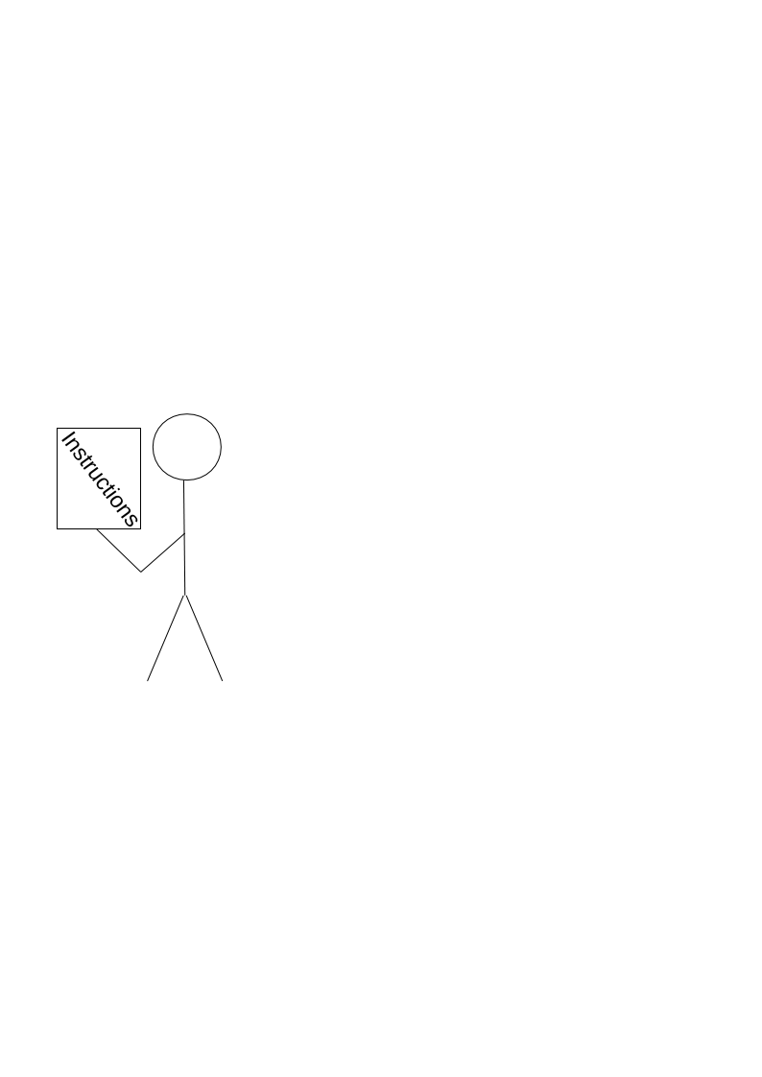
How?
Up to version 5.0.c
Make changes to share-config-custom.xml
Make changes to alfresco-global.properties

Slide 10
What changed?
New CMIS endpoint not available via the share proxy before 5.0.d

Slide 11
New CMIS endpoint
<endpoint>
<id>alfresco-api</id>
<parent-id>alfresco</parent-id>
<name>Alfresco Public API - user access</name>
<description>Access to Alfresco Repository Public API that require user authentication.
This makes use of the authentication that is provided by parent 'alfresco' endpoint.</description>
<connector-id>alfrescoHeader</connector-id>
<endpoint-url>http://localhost:8080/alfresco/api</endpoint-url>
<identity>user</identity>
<external-auth>true</external-auth>
</endpoint>

Slide 12
Patching
ALF-21367/MNT-15795 provides a patch to SlingshotAlfrescoConnector
Differences between 5.0.d and 5.1
(or see my github)

Slide 13
What happened to logout?
The property context.externalAuthentication causes the logout option to disappear
Quite easy to put back
This has changed frequently

Slide 14
Welcome to the Hotel California
You can check out but never leave
Logout returns you to the dashboard, which sends you to CAS, which logs you back in again

Slide 15
Lots of change
The way log out works has changed with every new version
Part of Aikau and hopefully more stable
Still hard to configure

Slide 16
Customize logout
Now need to subscribe to the ALF_DOLOGOUT event
Replace alfresco/services/LogoutService
Need to configure CAS logout page and logout destination

Slide 17
service.Xhr
Logout used to be GET now POST
By default Aikau changes the Content-Type to be application/json
Server side logout service doesn’t understand json
headers: { 'Content-Type': 'application/x-www-form-urlencoded' },

Slide 18
Invites
Complex interaction
Consider switching off invite emails

Slide 19
Passwords
Password not held in Alfresco any more
Fairly easy to change the password link in the header menu
Tab in profile not so easy
12

Slide 20

Sparse user info
Consider synchronizing with user repository
LDAP a good option
Allows access to non-web login

Slide 21
Resources
http://github.com/wrighting/alfresco-cas
http://tech.wrighting.org
@techwrighting
ian.wright@well.ox.ac.uk

Slide 22

Presentation Title
Presenter Name
Presenter Title

